Slide 1
Agus Mistiawan
Final Project – Web Application

Slide 2
User Story
As a user i want system that can
View List of Employee
Add Employee
Update Employee
Delete Employee
Search Employee
Filter Employee
Notes:
This is a user story and describe all the feature that we developt.
So, there are main goal of our final project.

Slide 3
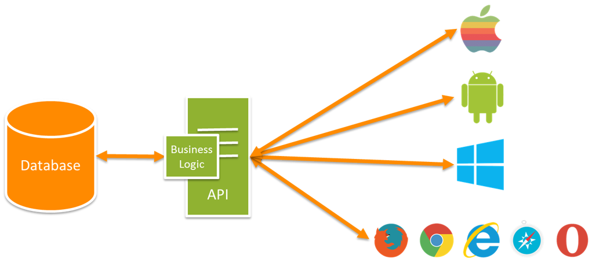
Technology
Server
RESTful API
Client
Angular2
Notes:
After knowing the feature i decided to developt that system with seperate application.
Server application.
Using Restful API (representational state transfer application program interface)
Based on HTTP request that can handle all feature before, such as delete,update,create and delete
Client application.
Angular2 simple frontend framework
Why sprated into two system? Reusable and easier to developt,
Sourec image : https://blogs.msdn.microsoft.com/martinkearn/2015/01/05/introduction-to-rest-and-net-web-api/

Slide 4

RESTful API
Spring Boot API
Object Relation Mapping
H2 Database
Notes:
Spring have dependency injection and have POJO (plain old java classes) automatic convert to JSON
The most use framework in java
Object Relation Mapping (Hibernate -> JPA) we dont need to create query just use depenceny form spring and jpa and we can update delete etc.
With orm we can use any type of RDMS without think obout they query
H2 Databse is a simple database for development

Slide 5

Angular2
TypeScript
Component-Based
Dependency Injection
Material Design
Notes:
Typescript is superset of javascript, it almost as readable as javca code, contains class, inheritence ,constructor
And it will be generate to javascript after running.
Component-based mean every part of webiste/ui has own component, has they own function. In the component there is as css html and typescript
Dependency Injection, because they are component based, so they can easily inject to another component they need

Slide 6
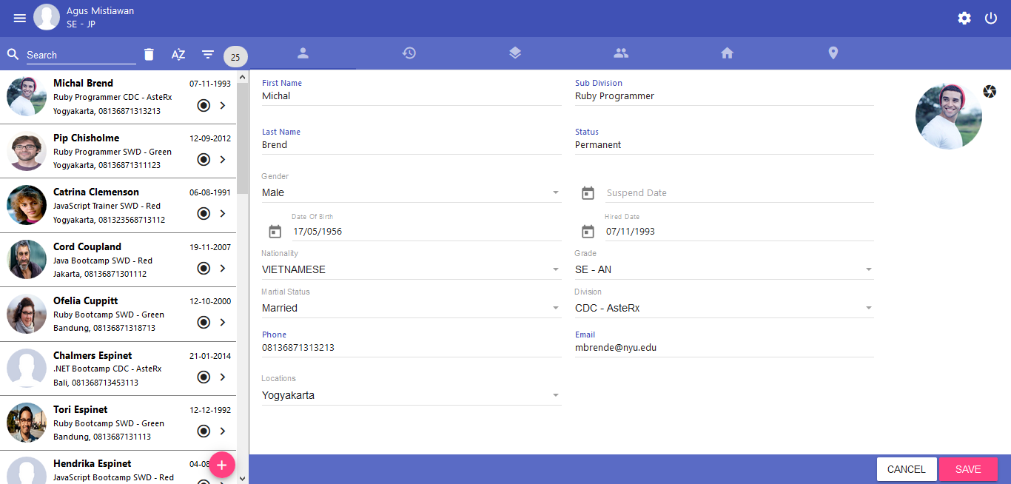
Web Application

Slide 7
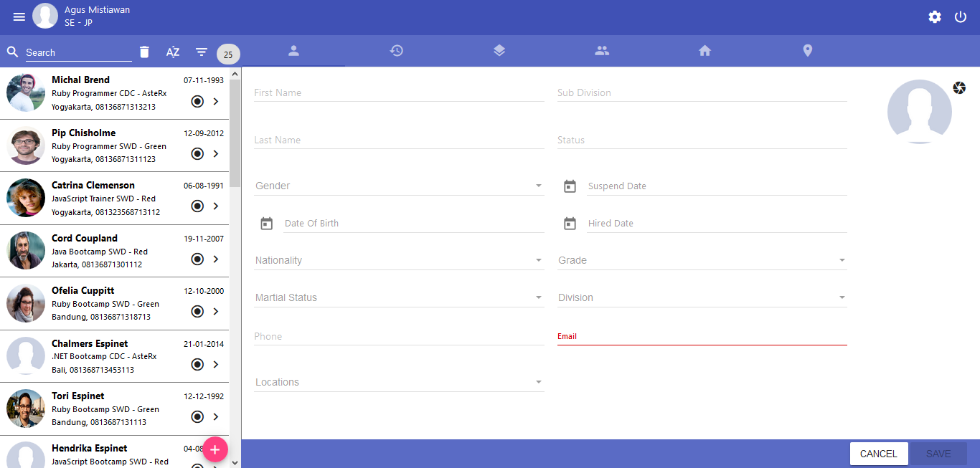
Add

Slide 8
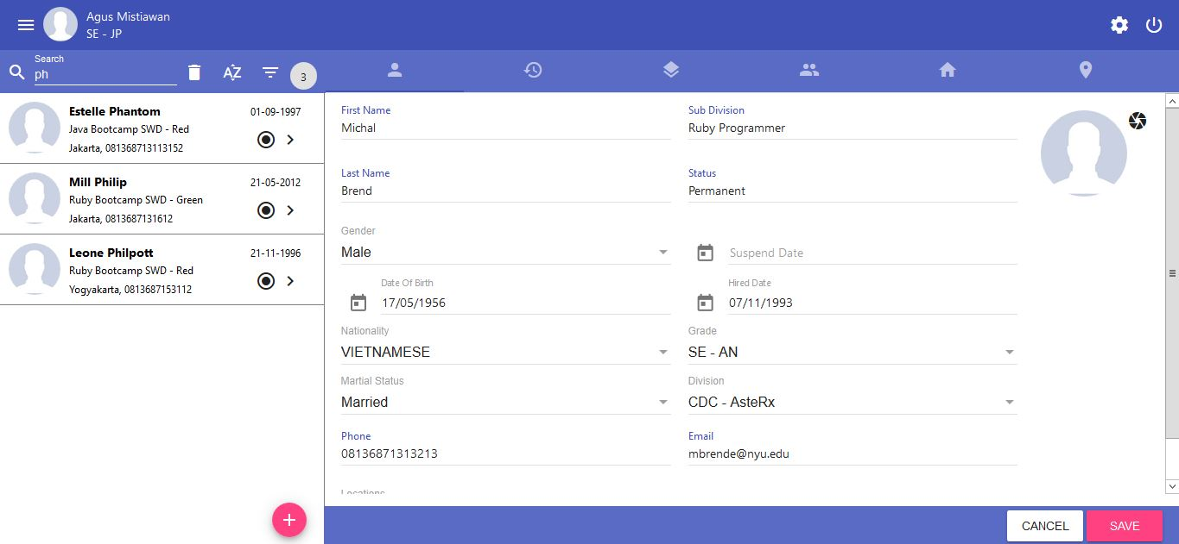
Search

Slide 9
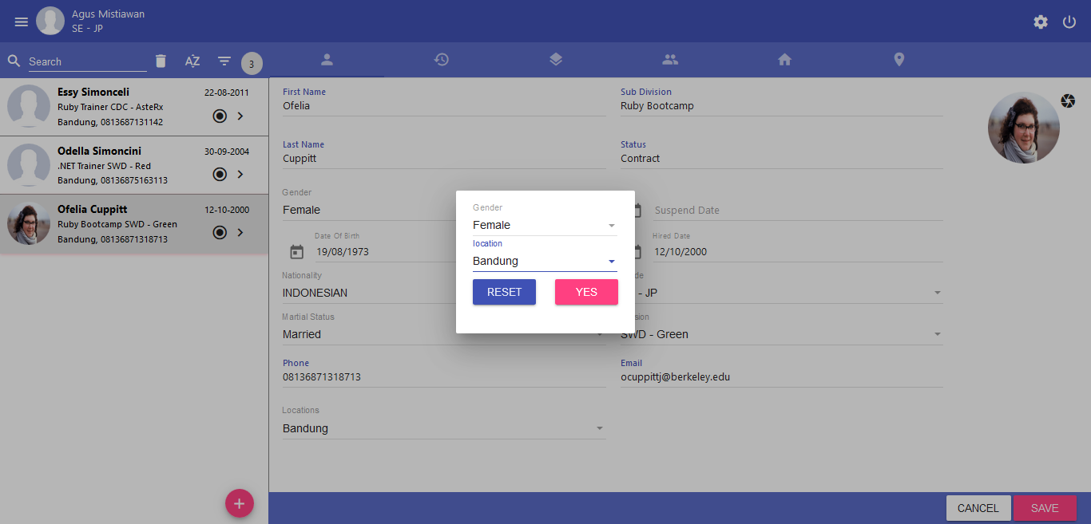
Filter

Slide 10
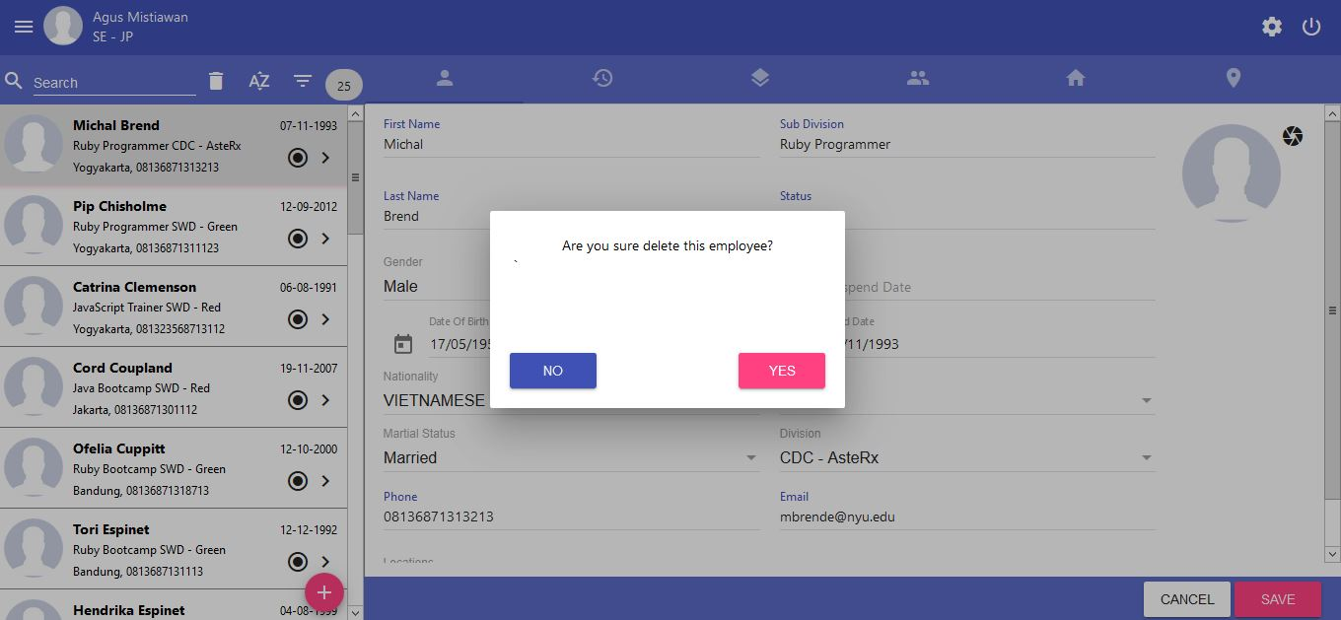
Delete

Slide 11
Conclusion
Learning and practice continuously
Communication

Slide 12
Thank you

